Slide 1

MyJewelry Web Application
By: Team 5
Prachi Patel, Muskan Babwani, Roshni Patel, Cole Czekala, Zaman

Slide 2
Description and Purpose (1)
The purpose of our jewelry search engine is to help users efficiently find and compare different types of jewelry products available from various online retailers.
Our Jewelry search engine allows users to search for specific types of jewelry as well as filter results by price, material, style, and other criteria.

Slide 3
Description and Purpose (2)
Expanding on the convenience of shopping directly through a browser, our web application returns only buyable items that fit the sizes, styles and budget you give when creating an account.
Additionally, our application works with an external provider (Instacart Transactions API) to allow for more convenient checkout than even Google shopping allows

Slide 4
Target Users
At the end of the day, our goal is to make money via royalties on the business our users bring to the online marketplaces we work with.
We target users that are more likely to benefit from our application and more like to bring us business, a win-win.
We achieve this by running ads on social media platforms such as Instagram and Facebook, where the users are already in a state of consumption and being exposed to unrealistic physical appearances.

Slide 5
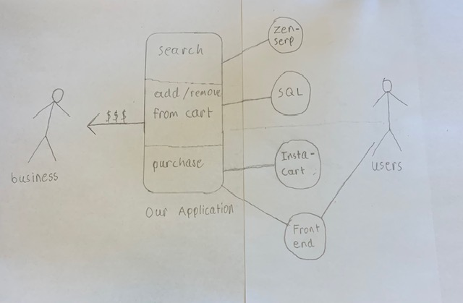
Use Cases

Slide 6
Platforms Used
Our application is accessed as a website and all of the following platforms are used in some part of the design process
Python, JavaScript, HTML, CSS, MySQL, Zenserp Scraper API , Instacart Transaction API

Slide 7
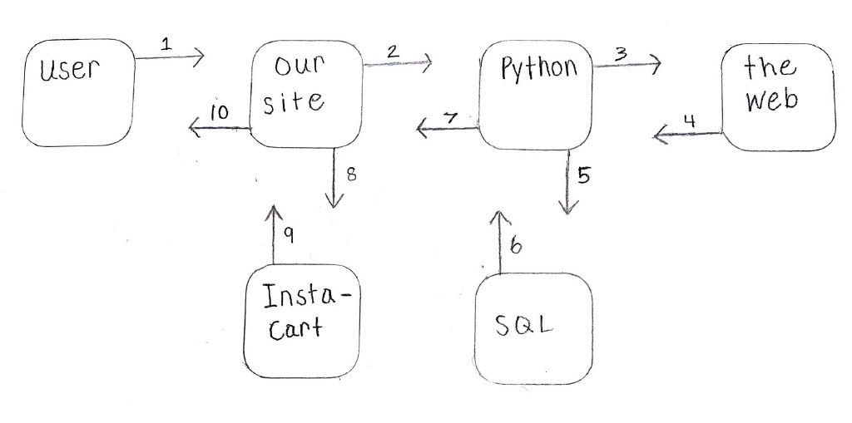
How They Are Used

